Slide 1

HTML5 Storage

Slide 2
Out line
Offline Storage
Local Storage & Session Storage
Indexed DB

Slide 3
Old way storing data
Uploading to server
Saving data in cookie
Notes:
When web developers think of storing anything about the user, they immediately think of uploading to the server or saving data in cookie. HTML5 changes that, as there are now several technologies allowing the app to save data on the client device. It might also be sync'd back to the server, or it might only ever stay on the client: that's down to you, the developer.

Slide 4
Behind the cookie
Store settings & identifying information
Extremely limited capacity, 4k limit per cookie
Sent with every HTTP request => higher bandwidth usage & slower request times
Old-school but cross-browser
Notes:
Cookies often store your settings for a website, such as your preferred language or location
Cookies can store a wide range of information, including personally identifiable information (such as your name, home address, email address, or telephone number)
Cookies have been around since the early days of the web. They were originally intended to associate a little data with the user, though these days, most applications only store identifying information, and store the rest of the user's data on the server. Still, the fact that cookies can store some data does put them in the category of offline storage. However, the data capacity is extremely limited, as low as 20 cookies limited to 4KB each according to specification. Just as important, cookies slow down network activity because they are transferred to and from the server inside HTTP headers.

Slide 5
What we want?
Work on the client
Has a lot of storage space
Persists beyond a page refresh
Isn’t transmitted to the server

Slide 6
HTML5 Web Storage
In key/value pairs form
Has API to retrieve/write data
Only supports String

Slide 7
Local Storage
VS
Session Storages
Stores data with no expiration
Data available even when the browser/tab is closed or reopened.
Stores data for one session
Data is cleared as soon as closing the browser, mostly for security purposes
Web storage data will not be available between different browsers

Slide 8
The good things ☺
App can work offline, be possible to sync
Large capacity 5 - 10MB/domain
Read in client (JS), easier programming, no server infrastructure required, no database queries needed
Support caching, boost performance, quickly render
Notes:
First, you can make your app work when the user is offline, possibly sync'ing data back once the network is connected again.
You can show a large amount of data as soon as the user clicks on to your site, instead of waiting for it to download again.
Offline technologies support caching and detailed control over caching process. Therefore, web apps can boot quickly and show data instantly.

Slide 9
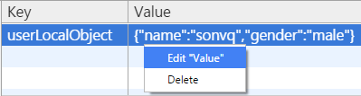
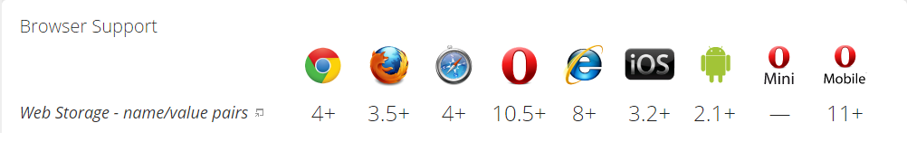
The bad things ☹
Security: lack of encrypted => use for non-critical data only
Usability: can't access from multiple clients/devices
Lack of automatically expiring storage
Browser: not fully supported
Notes:
Of course, the data is more vulnerable and the user can't access it from multiple clients, so you should only use it for non-critical data, e.g. a list of recent searches, in particular cached versions of data that's also "in the cloud".

Slide 10
When?
Making offline apps (Airplane activity)
Bandwidth, throughput, latency are important (Video apps)
Apps don’t have server-side or don’t want to force user login
Notes:
- Making offline apps just for airplane activity, which is the one place you're likely to be offline for a long period of time. But there are still situations where it's worthwhile, and also situations where offline technologies are useful for protecting against server or network outages.
- Although bandwidth is much faster these days, there are still noticeable limitations for certain applications, in terms of both throughput and latency. If you were designing a high-density video editor, you'll probably find the video is too big to fit into memory at once, meaning you have to swap content in and out of your app. It would be painfully slow to store the whole thing on a server (unless you and all your users are lucky enough to be on a super-fast network). Much better to store the entire video offline and push changes to the server as and when they happen.

Slide 11
Useful for
Save favorites, playlists, unsaved drafts/posts/comments
User profile, login username/email, remember checked options
Remember expanded/collapsed sections, layout options, auto-complete data
Thing that’s often the same
Notes:
- Making offline apps just for airplane activity, which is the one place you're likely to be offline for a long period of time. But there are still situations where it's worthwhile, and also situations where offline technologies are useful for protecting against server or network outages.
- Although bandwidth is much faster these days, there are still noticeable limitations for certain applications, in terms of both throughput and latency. If you were designing a high-density video editor, you'll probably find the video is too big to fit into memory at once, meaning you have to swap content in and out of your app. It would be painfully slow to store the whole thing on a server (unless you and all your users are lucky enough to be on a super-fast network). Much better to store the entire video offline and push changes to the server as and when they happen.

Slide 12
App cache
VS
Offline Storages
Save app's core logic & UI
HTML, JS, CSS, IMGs, etc
Load immediately next time
Save user-specific data
Restore the state of app
Save local every10s, upload server every 5m => bandwidth saving
Notes:
Imagine a game. Application caching would retain the initial HTML document, the JavaScript, the CSS, frequently used icons and images for game characters and scenes, and sound samples. Consequently, the next time the user visited the site, it would load immediately.
In our game example, visiting the site the second time round would load the site instantly, but what if we wanted to let the user continue playing the game from a previous position, i.e. we'd like to restore the state of the game. The kind of data required is not held in the application cache, because it's user-specific, so this is a job for offline storage. Whenever the user hits save, we upload to the cloud but we also store game data on disk at the same time, i.e. store it offline (for example, we might save the player's health level and the states of all objects and characters inside the game universe). We might even keep a loop running to continuously store the game data offline. That way, the latest changes are still there if the user lost connectivity and had to shut down the browser before they could get online again. It also takes less bandwidth than continuously uploading state to the server, e.g. we might save data locally every 10 seconds, while uploading it only every 5 minutes as a bandwidth-saving measure.

Slide 13
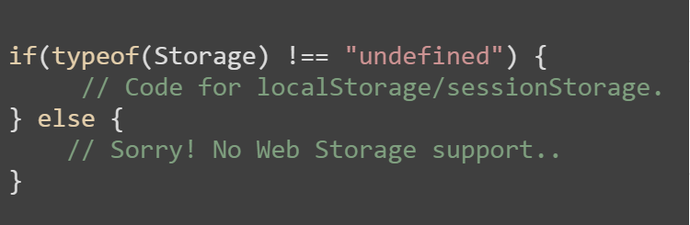
How to use
Check browser support

Slide 14




How to use
SET
GET
DELETE
CLEAR ALL

Slide 15
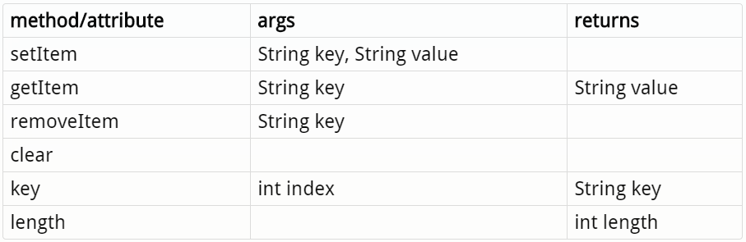
How to use

Slide 16
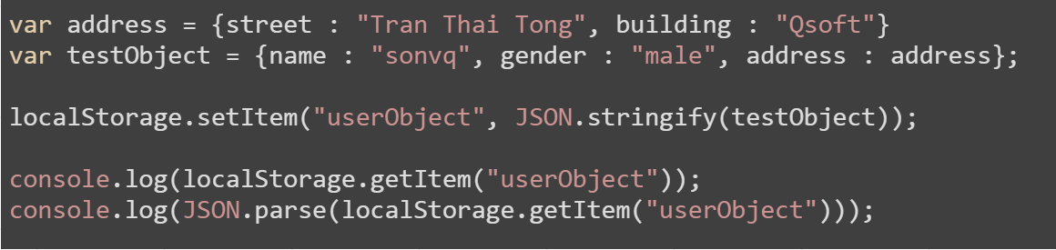
How to use
localStorage only supports String
Deal with obj & array: use JSON.stringify() & JSON.parse()
Notes:
var address = {street : "Tran Thai Tong", building : "Qsoft"}
var testObject = {name : "sonvq", gender : "male", address : address};
localStorage.setItem("userObject", JSON.stringify(testObject));
console.log(localStorage.getItem("userObject"));
console.log(JSON.parse(localStorage.getItem("userObject")));

Slide 17
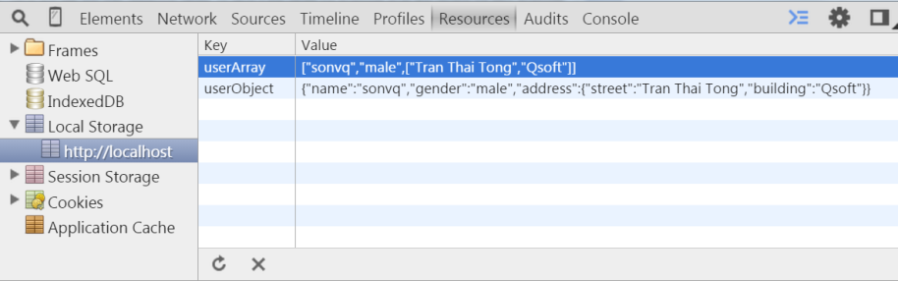
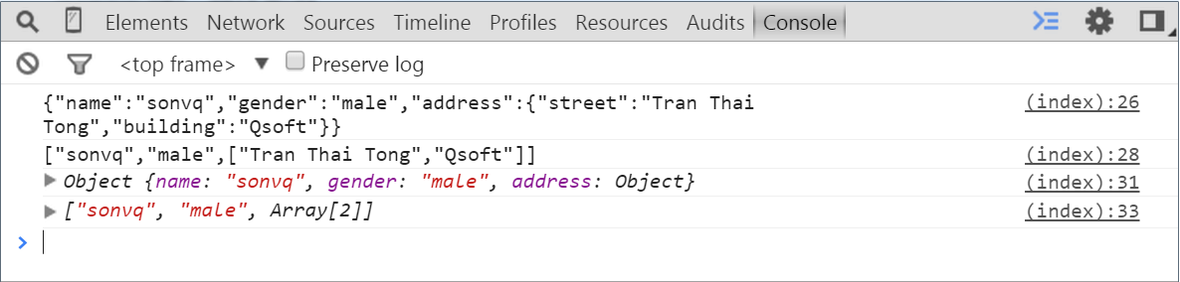

Slide 18

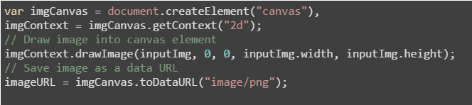
How to use
Deal with image & file: use dataURL => base64
Notes:
var reader = new FileReader();
// Read in the image file as a data URL.
reader.readAsDataURL(f);
var imgCanvas = document.createElement("canvas"),
imgContext = imgCanvas.getContext("2d");
// Save image as a data URL
storageFiles.elephant = imgCanvas.toDataURL("image/png");

Slide 19
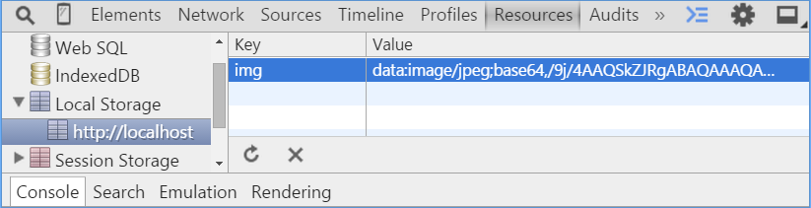
How to use
Notes:
var reader = new FileReader();
// Read in the image file as a data URL.
reader.readAsDataURL(f);
var imgCanvas = document.createElement("canvas"),
imgContext = imgCanvas.getContext("2d");
// Save image as a data URL
storageFiles.elephant = imgCanvas.toDataURL("image/png");

Slide 20
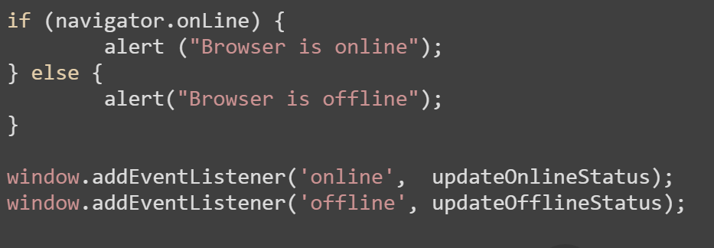
How to use
Check browser is online/offline
Notes:
if (navigator.onLine) {
alert ("Browser is online");
} else {
alert("Browser is offline");
}
window.addEventListener('online', updateOnlineStatus);
window.addEventListener('offline', updateOfflineStatus);

Slide 21
How to use
Check browser online/offline
Offline.js Heyoffline.js
Offline.check() onOnline()
Offline.state onOffline()
Offline.on (event, handler, context)
Offline.off (event, handler)
http://github.hubspot.com/offline/docs/welcome/ http://krawczyk.io/heyoffline.js

Slide 22
Full of Storage?
Browser checks remaining space for current domain?
If yes
Data is stored, overwrite if the same key exists
If no
Data is not stored, no existing data is overwritten
A QUOTA_EXCEEDED_ERR exception is thrown
Notice
Opera displays a dialog giving choice to increase storage space

Slide 23
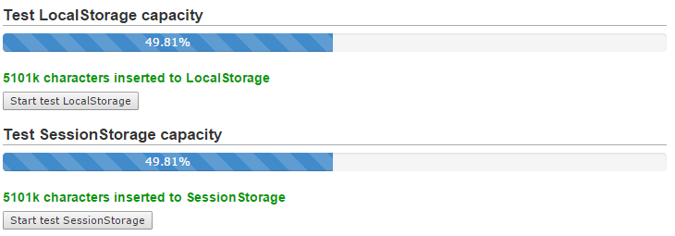
Full of Storage?
Test LocalStorage and SessionStorage in Chrome 41

Slide 24
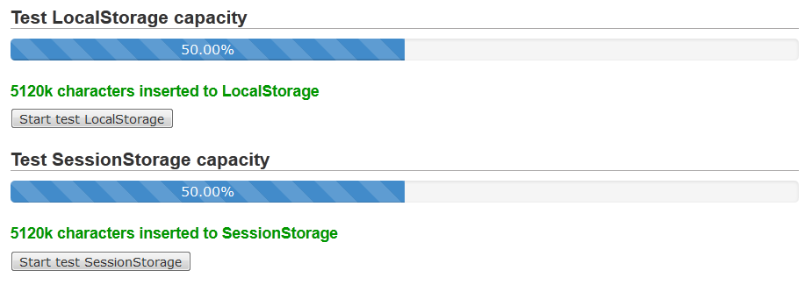
Full of Storage?
Test LocalStorage and SessionStorage in Firefox 34

Slide 25
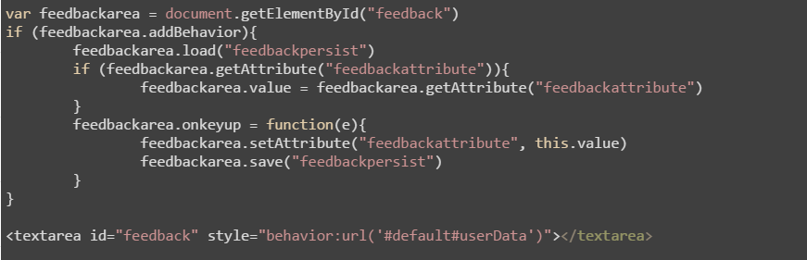
Old browser?
userData in IE5-7

Slide 26
Old browser?
amplify.store
store.js
lawnchair
locache
jstorage
Use localStorage when available
Fall back on userData in IE5-7
Fall back on in-memory store if none storage types available

Slide 27
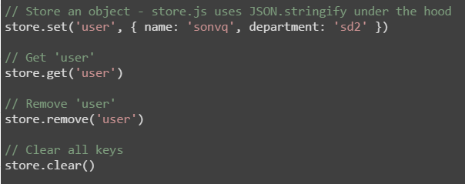
Old browser?
Example with store.js

Slide 28
Demo
save-storage.html
save-image.html
full-storage.html
online-offline.html
online-offline-status.html
old-browser.html
Notes:
Link trong truong hop host http:http://128.199.89.119/demo/ls/save-storage.html
//thieusmith.com/ bi die

Slide 29
THANK YOU FOR YOUR ATTENTION!

